Slide 1
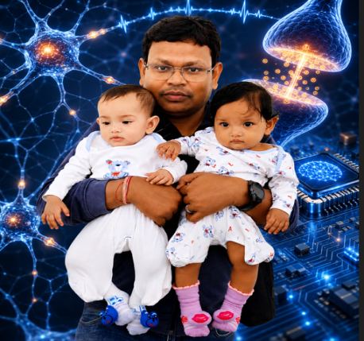
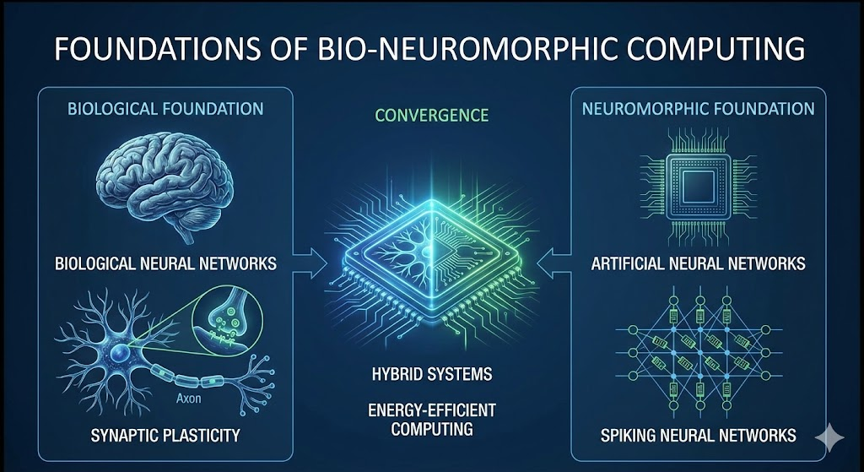
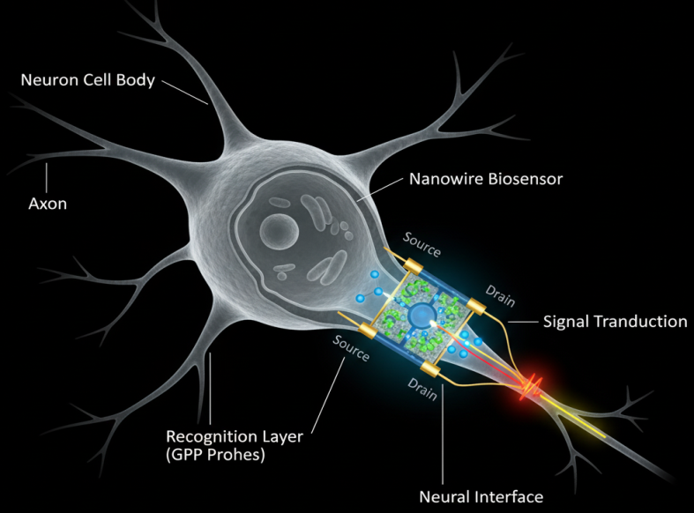
Faculty and Research Interests
Sankar Prasad Bag
Assistant Professor
Phone: +886-972409660
Email: sbag@mail.ntust.edu.tw
Education:
2018 Ph.D. Electronics Engineering,
Chang Gung University
Experience:
2026/06 ~ now: Assistant Professor, Dept. of Computer Science and Information Engineering, National Taiwan University of Science and Technology, Taiwan (ROC)
2024/09 ~ 2026/05: Associate Professor, School of Electronics & Communication Engineering, REVA University, India
2022/10 ~ 2024/08: Postdoctoral Researcher, Graduate Institute of Communication Engineering, Dongguk University, Seoul, South Korea
2024/09 ~ 2026/05: Assistant Professor, School of Electronics & Communication Engineering, MITS University, India
2018/07~2020/06: Postdoctoral Researcher, School of Aeronautics and Astronautics, Zhejiang University, Hangzhou, China
Teaching Interest: Neurmorphic Computing / NeuroVLSI / IoT / Quantum computing/ Operating Systems / Microcomputer Architecture and Applications
Research Interest:
Neuromorphic Computing, NeuroVLSI Design, Neuro-Biosensors for Smart Healthcare, Brain-Computer Interfaces (BCI), Bio-Neuro Inspired Edge AI, Quantum-Inspired ML.
Award:
IEEE Senior Member
2013 Taiwan scholarship recipients (Ministry of Education, Taiwan) for a research program
Current Project:
Designing an analytical approach using neuromorphic IoT devices to differentiate bloodstains and fingerprints from non-biological materials, REVA Research center, India
BCI technique

